Slide 1
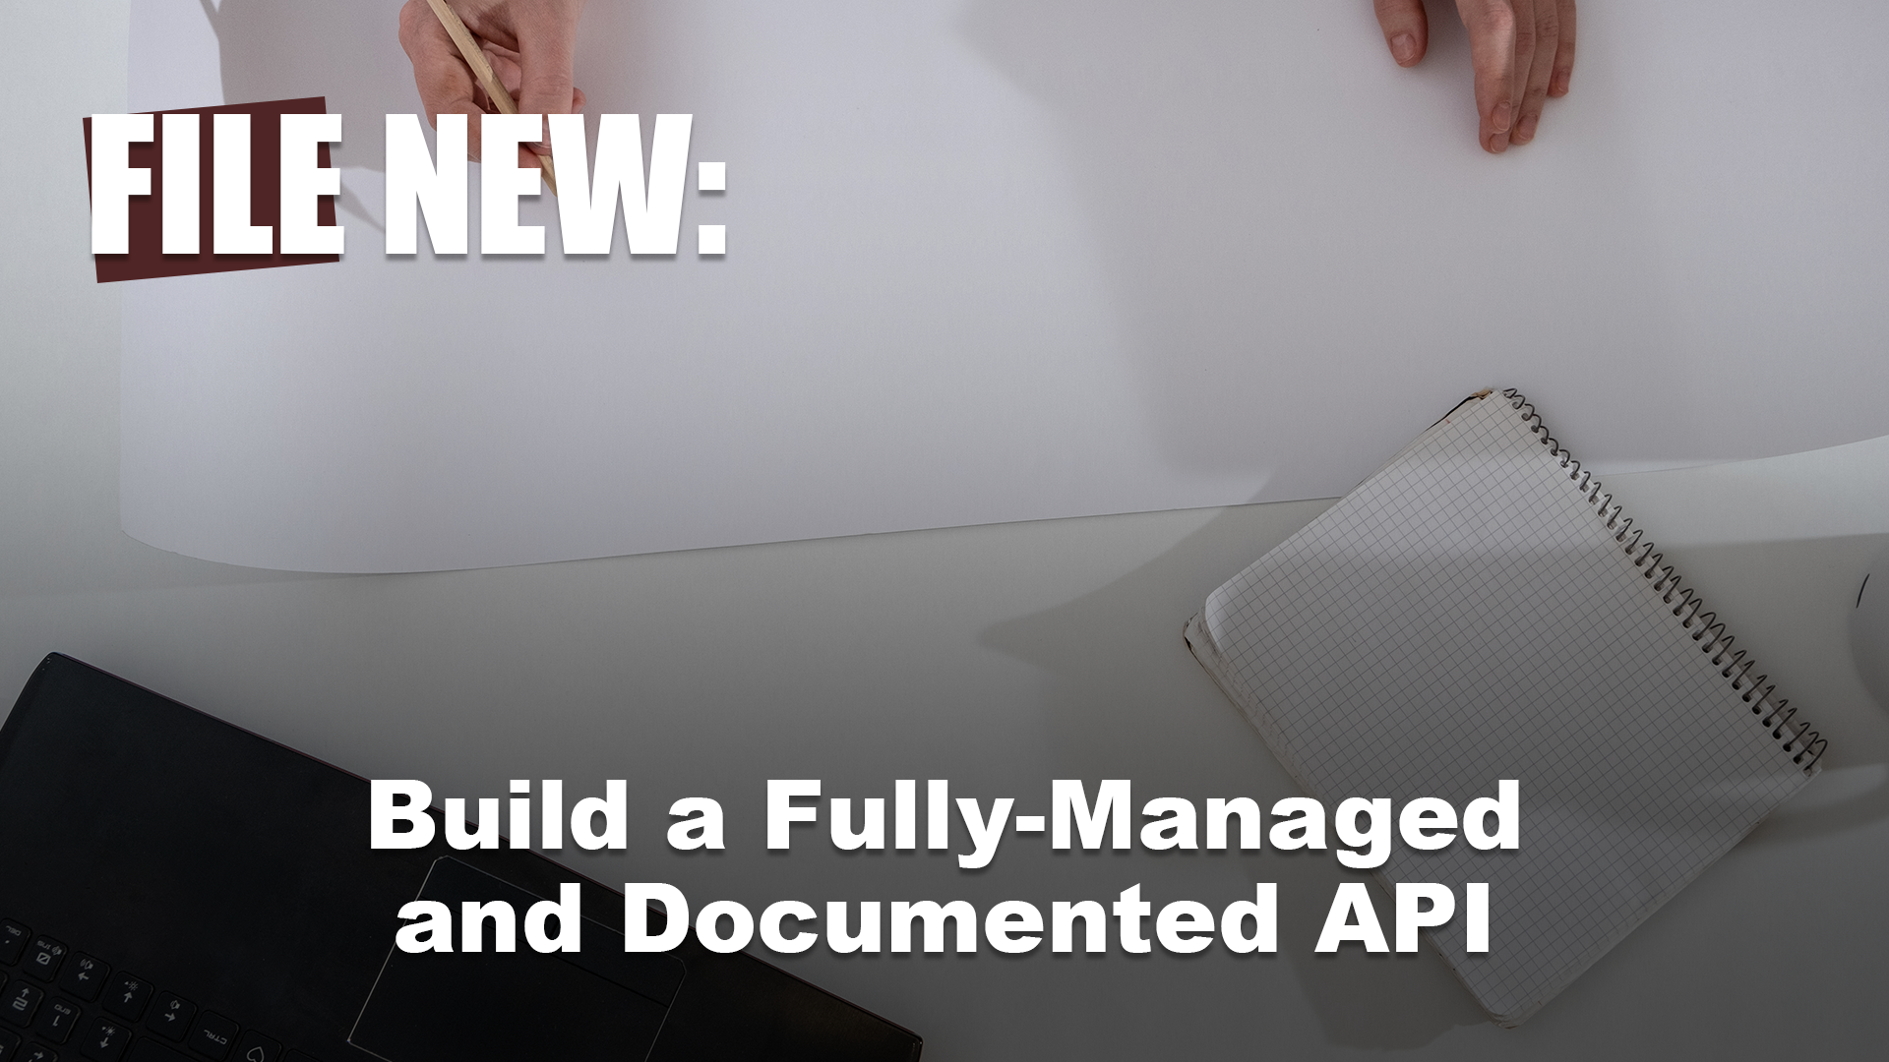


Slide 2


Slide 3







Who is Chad Green?
chadgreen@chadgreen.com
TaleLearnCode
ChadGreen.com
ChadGreen & TaleLearnCode
ChadwickEGreen

Slide 4
Public Service
Announcement

Slide 5

Public Service
Announcement

Slide 6






Listen to your body

Slide 7


Listen to your body

Slide 8
API Management Basics (Not Azure API Management Basics)
File New: Build a Fully-Managed and Documented API

Slide 9
What’s the problem?

Slide 10

What’s the problem?
Notes:
Who has the APIs I need?

Slide 11

What’s the problem?
Notes:
What are the APIs that are available?

Slide 12

What’s the problem?
Notes:
When can I use the APIs?

Slide 13

What’s the problem?
Notes:
Where are the endpoints?

Slide 14

What’s the problem?
Notes:
Why should I use your API?

Slide 15

What’s the problem?
Notes:
How do I use the APIs

Slide 16
What is API Management?

Slide 17
What is API Management?
Creating
API Connections
Publishing
API Connections
Managing
API Connections
Notes:
API management refers to the process of creating, publishing, and managing API connections in a secure and scalable environment. The goals of API management is to ensure that the needs of developers and applications that may use the APIs are being met.
API management is more than just a place for API connections to live. And while API management needs will differ from organization to organization, [CLICK] there are several pieces of functionality generally common with API management systems:

Slide 18
What is API Management?
Creating
API Connections
Publishing
API Connections
Managing
API Connections
Notes:
there are several pieces of functionality generally common with API management systems:

Slide 19
What is API Management?
Creating and Publishing APIs
Enforcing Usage Policies
Controlling Access
Nurturing Developer Community
Tracking Usage
Performance Reporting
Notes:
there are several pieces of functionality generally common with API management systems:
Creating and publishing APIs
Enforcing their usage policies
Controlling access
Nurturing the developer community
Collecting and analyzing usage statistics
Reporting on performance

Slide 20
API Management Use Cases

Slide 21

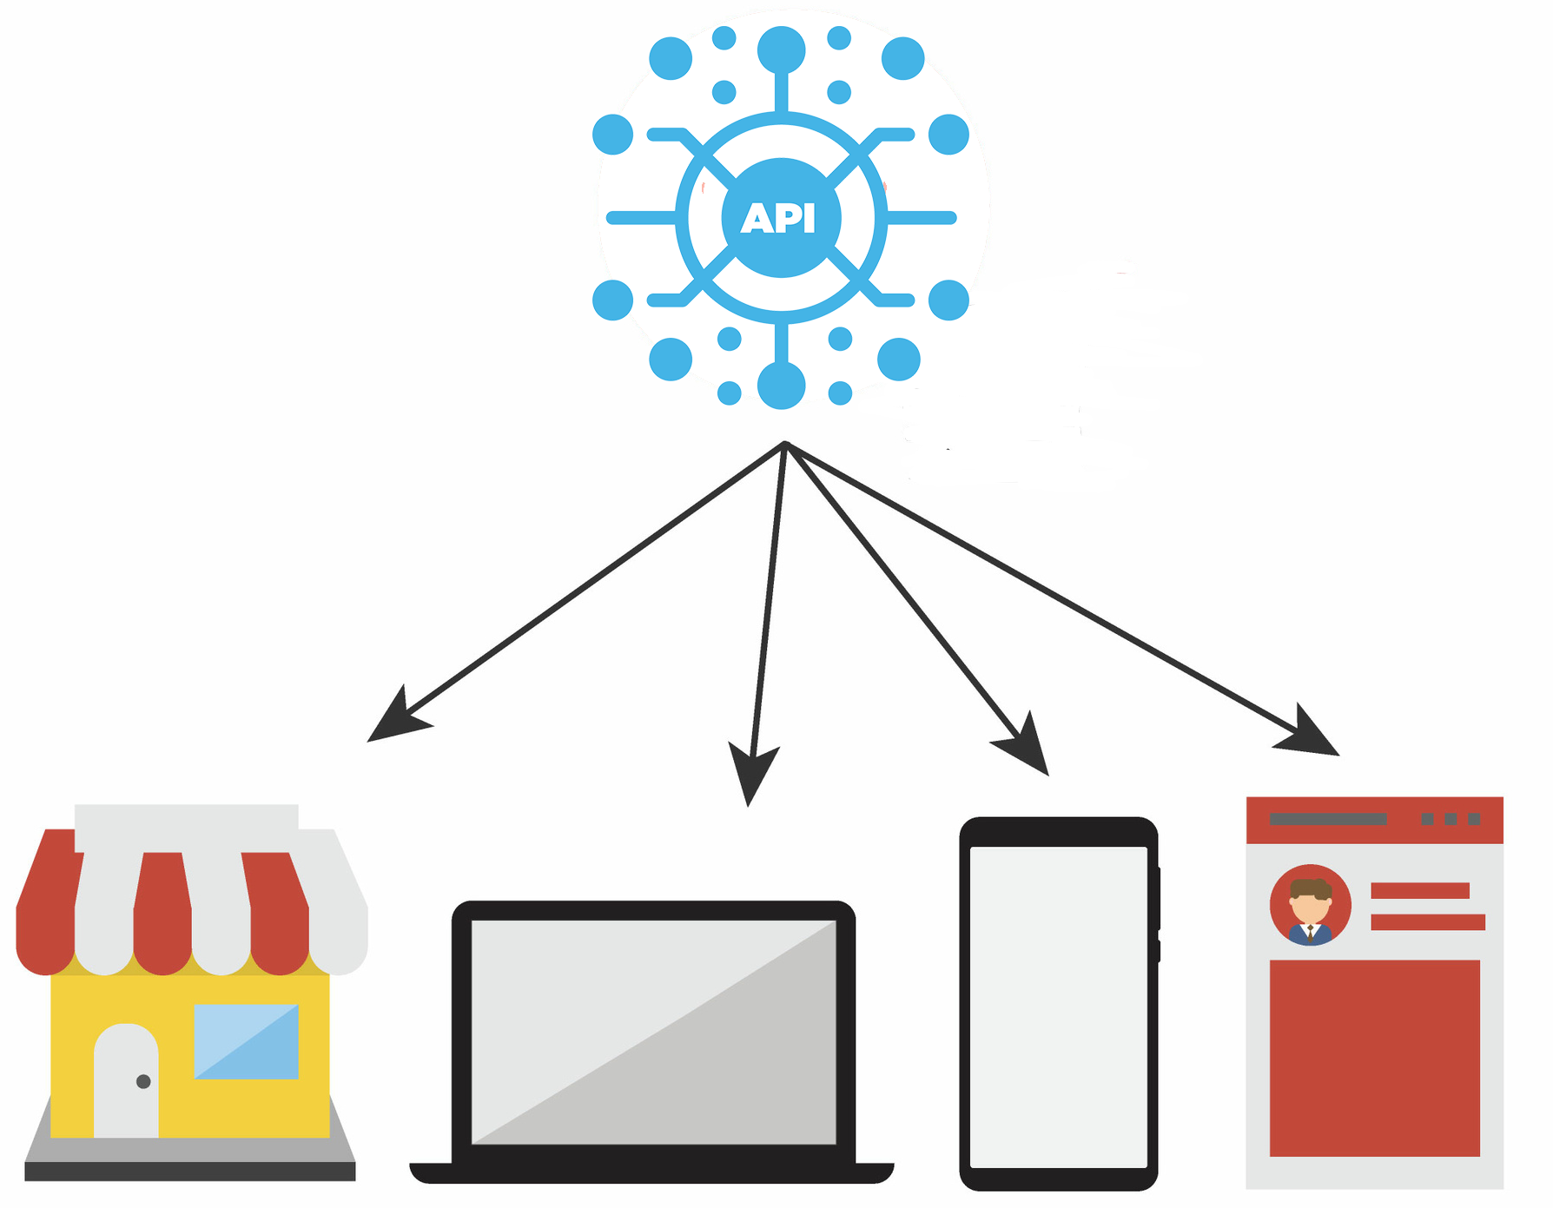



API Management Use Cases
API Integration
Multi-Channel
User Experiences
B2B Integration
Data as a Service
Unlocking
Legacy Assets
API Integration
Notes:
API Integration
API integration is the process of connecting two or more applications via their APIs to perform a joint function. The connection is made through the API layer of each application to make them talk to one another. API integration ensures that applications which are connected represent the most up-to-date data while providing data integrity across a technology stack without having to worry about versioning. Some API management solutions come pre-installed with out-of-the-box integrations, while other require more complex integrations.

Slide 22
API Management Use Cases
API Integration
Multi-Channel
User Experiences
B2B Integration
Data as a Service
Unlocking
Legacy Assets
Multi-Channel User Experiences
Notes:
Multi-Channel User Experiences
APIs are frequently used to enable user experiences such as web, mobile, wearable, or IoT applications. Reuse APIs to accelerate development and ROI.

Slide 23
API Management Use Cases
API Integration
Multi-Channel
User Experiences
B2B Integration
Data as a Service
Unlocking
Legacy Assets
B2B Integration
Notes:
B2B Integration
APIs exposed to partners and customers lower the barrier to integrate business processes and exchange data between business entities. APIs eliminate the overhead inherent in point-to-point integration.
B2B integration, refers to the automation of communication and business processes of two or more organization. This integration delivery style enables them to work more effectively with customers, suppliers, and business partners through business process automation.
B2B integration pulls information form an internal source application and transfers it to an end external application via secure data movement and an integration platform.

Slide 24
API Management Use Cases
API Integration
Multi-Channel
User Experiences
B2B Integration
Data as a Service
Unlocking
Legacy Assets
Data as a Service
Notes:
Data as a Service
Data as a Service is a type of data management strategy that uses the cloud to deliver data storage, integration, processing, or analytic services via a network connection. DaaS tools remove the need for organizations to install and manage software or hardware locally. DaaS allows organizations to begin storing and processing data quickly, and can be more scalable than on-prem alternatives since more users can be allocated to cloud workloads. DaaS tools are usually managed automatically and kept up-to-date by the provider.

Slide 25
API Management Use Cases
API Integration
Multi-Channel
User Experiences
B2B Integration
Data as a Service
Unlocking
Legacy Assets
Unlocking Legacy Assets
Notes:
Unlocking Legacy Assets
APIs are used to abstract and modernize legacy backends and make them accessible from new cloud services and modern applications. APIs allow innovation without the risk, cost, and delays of migration.

Slide 26
API Management Use Cases
API Integration
Multi-Channel
User Experiences
B2B Integration
Data as a Service
Unlocking
Legacy Assets

Slide 27
API Management Marketplace
File New: Build a Fully-Managed and Documented API

Slide 28














API Management Offerings

Slide 29
Azure API Management
Publish APIs to developers, partners, and employees securely and at scale

Slide 30
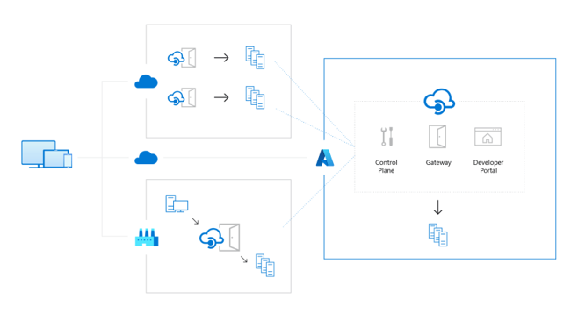
Manage APIs across clouds and on-premises
Notes:
Manage APIs across clouds and on-premises
Deploy API gateways side-by-side with the APIs hosted in Azure, other clouds, and on-premises, optimizing API traffic flow. Meet security and compliance requirements while enjoying a unified management experience and full observability across all internal and external APIs.

Slide 31
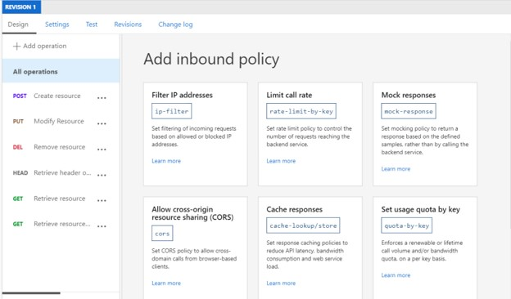
Protect your resources
Notes:
Help protect your resources
Control how data and services are exposed to employees, partners, and customers by applying authentication, authorization, and usage limits.

Slide 32
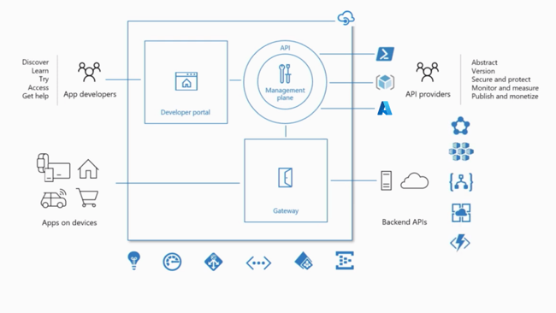
Accelerate your business
Notes:
Accelerate your business
Build apps faster and deliver immediate value to your customers through API-first approaches. Decouple front- and back-end teams through API mocking, API revisions and versioning, and automated API documentation.

Slide 33
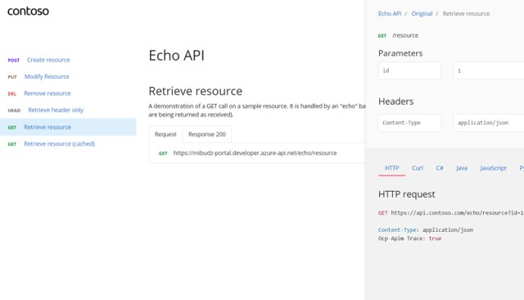
Improve API discoverability
Notes:
Improve API discoverability
Create a customizable developer portal for all your APIs. Easily manage and share APIs with internal teams, external partners, and customers.

Slide 34
Transform existing services
Notes:
Transform your existing services
Automatically turn legacy web services into modern REST-based APIs by creating façades for your back-end services. See how innovators like Vipps, a leading payment service in Norway, are revolutionizing development using Azure API Management.

Slide 35
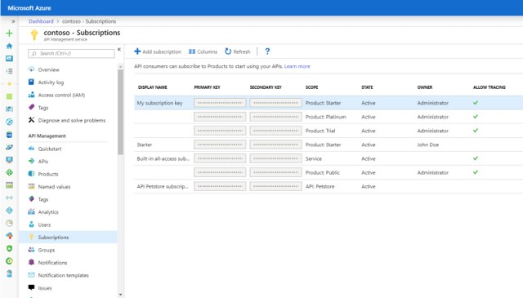
Secure your APIs
Notes:
Help secure your APIs
Keep all your APIs behind a single static IP or domain, and help protect them with keys, tokens, and IP filtering.
Enforce flexible and fine-grained quotas and rate limits. Modify the shape and behavior of your APIs using policies. Improve latency and scale your APIs with response caching.
Connect on-premises APIs to cloud services by creating a façade that lets you safely integrate on-premises and cloud environments.

Slide 36
Demo Time
File New: Build a Fully-Managed and Documented API

Slide 37
Demonstration
Create an Azure API Management instance
Mock API responses
Create and publish a product
Import an API
Transform responses
Add rate limiting
Setup CORS
Caching
Developer Portal

Slide 38

Questions?
chadgreen@chadgreen.com
TaleLearnCode
ChadGreen.com
ChadGreen & TaleLearnCode
ChadwickEGreen

